Slide 1
A Base for Reinforcement Learning-enabled Solitaire
Fifth Semester Project
2258 90304

Slide 2
SDL2-based Klondike Clone, ‘aisolGUI’
Klondike Solitaire, the popular board game, is widely available across multiple platforms. Therefore, the aim of this project is not to make a superior Solitaire implementation, but one tailored specifically for integrating a RL (reinforcement learning) agent to play the game.
At the moment the base game implementation is ready, although needs to be transformed to communicate with the environment, and by extension the agent and/or model.
Although the base classes (Card and Pile) contain modular implementations with lots of different specialised functions, the handling of these classes in class Deck is pretty monolithic.

Slide 3
Implementation details
Klondike Solitaire, containing 52 cards across four suits, has been created, including the game rules, object handling, rendering and window management. This is done entirely from scratch with external image assets included from a Creative Commons source (attributions provided in the repository).
The rendering is handled using techniques such as batch processing and dirty rectangles, thus increasing idle CPU efficiency and power friendliness. The program is compiled with the MinGW port of the GNU C++ Compiler (GCC).
Mouse input is fully supported and (mostly) optimal, alongside a screen-system for navigating to and from home and settings screens.

Slide 4
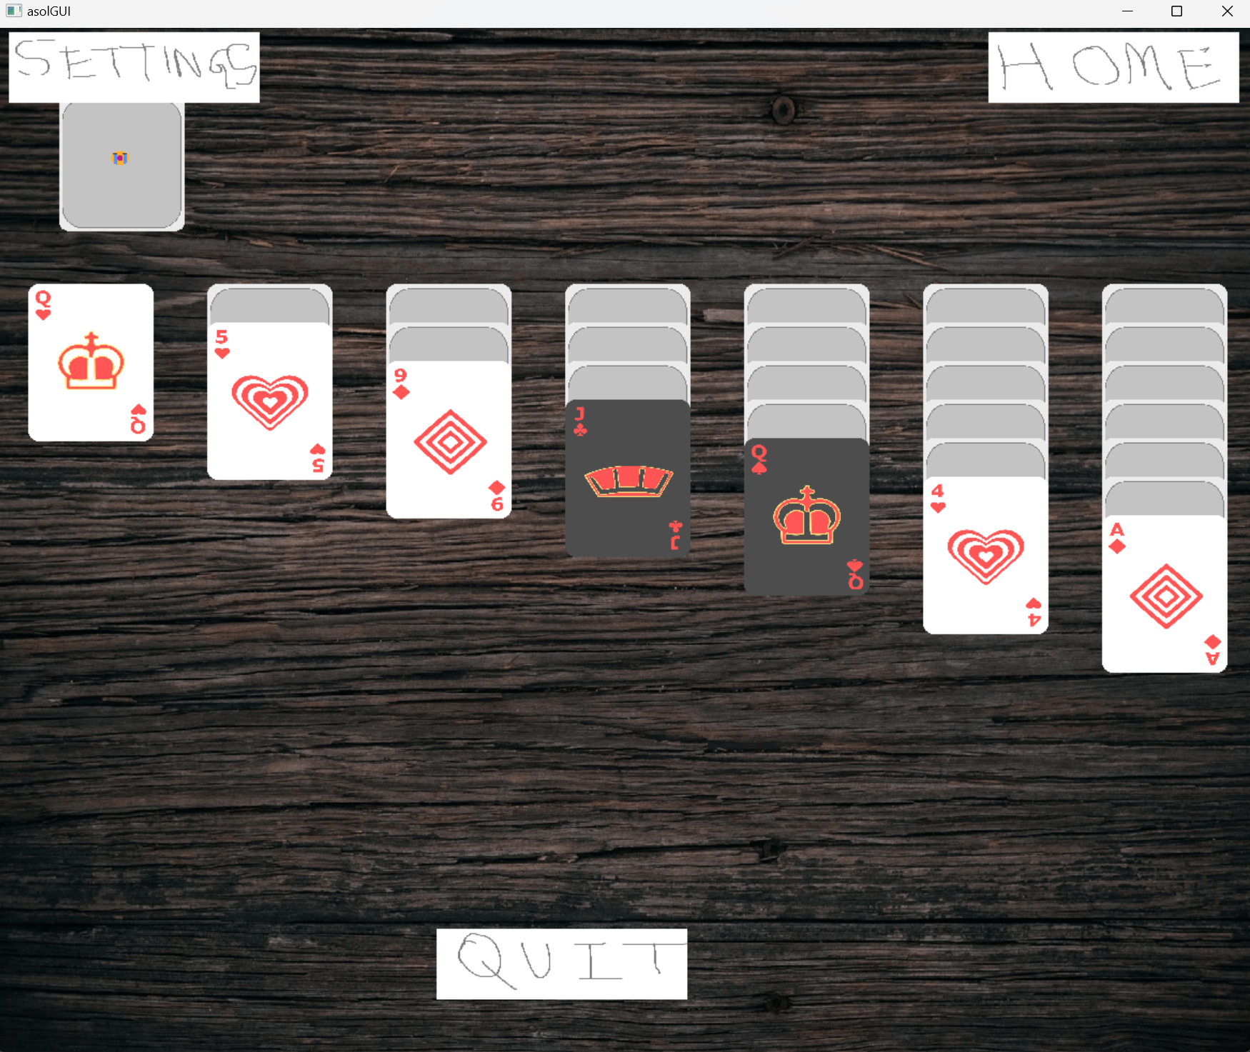
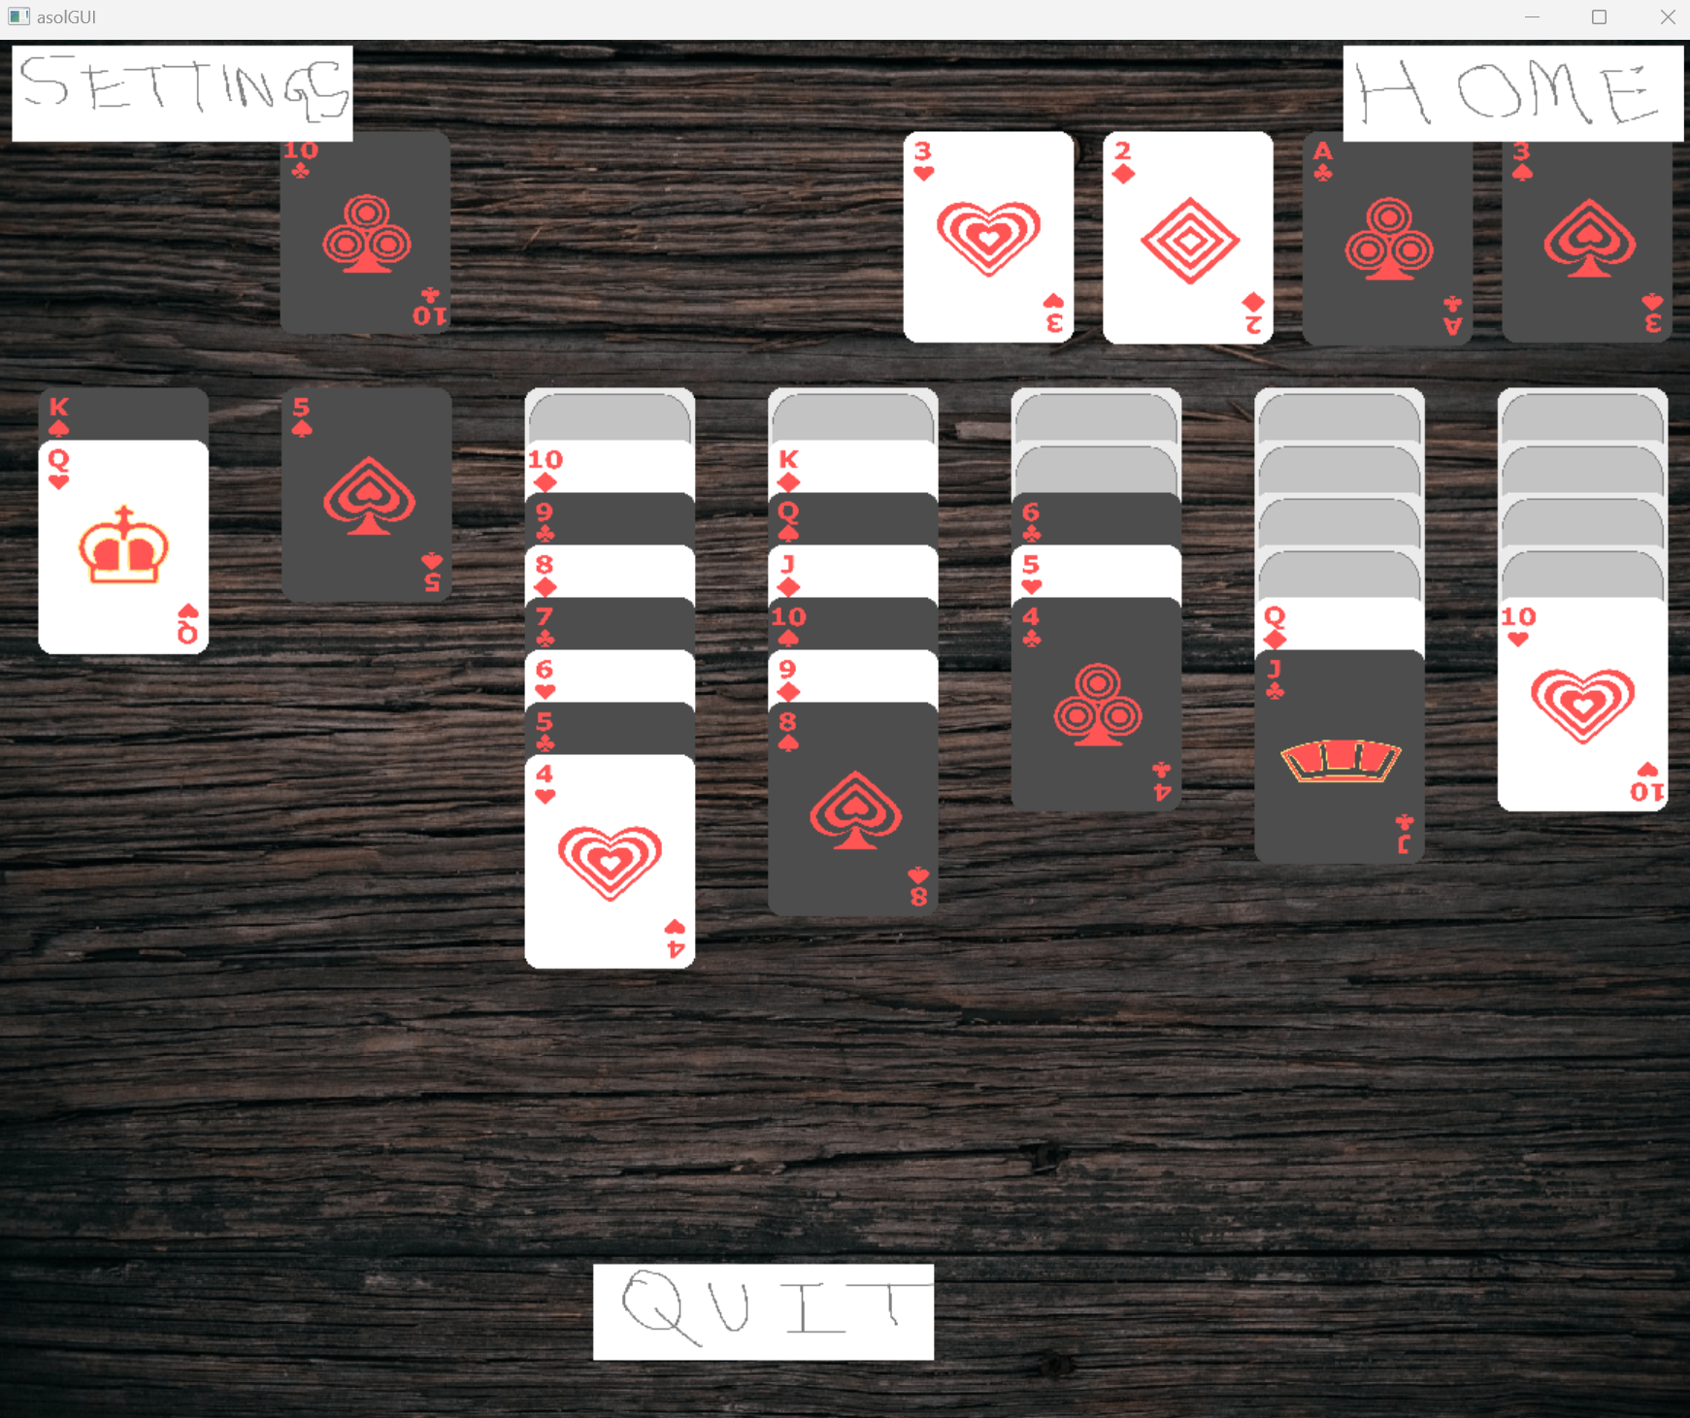
Screenshots

Slide 5
Classes: Card
Suit: an enum class to represent each of the four suits in a typical Klondike Solitaire game: Hearts, Diamonds, Clubs and Spades.
Card: represents one among the fifty-two cards available in a typical Klondike deck. The class stores private members: suit of object type Suit, an integer rank, a pointer to its corresponding card texture (loaded dynamically at runtime), a Rectangle structure for describing the position of the card in the GUI, and other rule-based members. The methods in the class are designed to access and modify these members across varying game modes of Solitaire.

Slide 6
Classes: Pile
Pile: a pile is one of the basic collections of cards in a Solitaire game. In Klondike, these are the stock, waste (talon), the foundations, and the tableaus. In aisol, each pile stores card information using an std::vector of Card* object pointers.
Dispensable to the Pile class are a range of methods to access and modify its members, as well as directly perform graphical operations on themselves. The pile class also holds a pileTexture member, which is a base for the applied batch render optimisation.

Slide 7
Classes: Deck
Ultimately, the Card objects themselves are created and stored in a cardStore vector, and then utilised as pointers across the different piles, all from a Deck class. This class implements the Solitaire game rules and encapsulates the functionality of each distinct game of Klondike.
In the current implementation, at any time only a single game of Klondike may be run. However, the encapsulation model permits extensibility for running multiple games together in parallel.
All graphical operations are also encapsulated, thus providing a streamlined mode to control texture rendering and resize operations.

Slide 8
Namespaces
Logic is a namespace containing specialised functions for verifying valid moves respective to the rules of classical Klondike.
Operations contains functions designed to accept input and perform changes to the current Deck, primarily with regards to card movements and state tracking.
Statistics stores and monitors scores and game objectives (such as win/lose conditions), perhaps facilitatating the core flow of the game.
Meta stores and processes meta-information for the program, primarily buttons, background texture, coordinates and size logic.

Slide 9
Global Functions
Each distinctive screen is segmented into its own ‘loop’ function (GameLoop(), SettingsLoop(), and HomeLoop()), responsible for handling the screen drawing and management logic for itself during the lifetime of the program.
A special wrapper ‘SDLW’ namespace is utilised throughout the program for convenient and organised access to SDL’s library functions, which by themselves are formatted according to C syntax.
The main() function finally handles the appropriate function calls to the initialisation and clean-up parts of the code, as well as the primary loop of the program runtime.

Slide 10
Additional information
Single file implementation can be compiled with any code editor and primarily any compiler with support for C++14. I myself work on this with Sublime Text 4 configured to build with mingw’s g++ on Windows 11. As of now, being contained to a single file would mean it does not require a build system.
As of now, I track a 300-400mib of RAM usage (450+ during resize and continuous redraw), and upto 0.7% CPU load on a 13th generation Intel laptop, from system-intensive functionalities such as resize, although some of it might be from the polling rate in my mouse.
The system could definitely be refactored and optimised a lot further.

Slide 11
End
Project by 225890304 (roll no. 31)
Computer Science (AI), Section C

